Slide 1


GOVT. ARTS COLLEGE (A) . SALEM-7 DEPARTMENT OF COMPUTER APPLICATIONS
title
Department Library Management System
MINI PROJECT REVIEW
Project Guide : Dr.C.Senthamarai MCA., Ph.D.,
NAME : DHANAJAYAN K
REG NO : 22PCA242505
CLASS : II MCA

Slide 2

GOVT. ARTS COLLEGE (A) . SALEM-7 DEPARTMENT OF COMPUTER APPLICATIONS
title
Department Library Management System
NAME : DHANAJAYAN K
REG NO : 22PCA242505
CLASS : II MCA
2
MINI PROJECT REVIEW
Project Guide : Dr.C.Senthamarai MCA., Ph.D.,

Slide 3
Presentation flow
INTRODUCTION
PROPOSED SYSTEM
Abstract
FLOW Diagram
REQUIREMENTS
Input/output Design
MODULES
Database Design
EXISTING SYSTEM
conclusion
title
Department Library Management System

Slide 4




Abstract
A Department(ca) Library Management System is a project that manages and stores books information electronically according to student and staff needs.
The system helps admin to keep a constant track of all the books available in the department library.
In this system allows admin, FACULTY and student to search the desired book.
It becomes necessary for department to keep a continuous check on the books issued and returned and even calculates the fine.

Slide 5



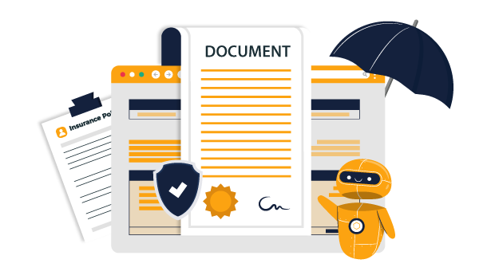

Abstract
A Department Library Management System is a project that manages and stores books information electronically according to student and staff needs.
The system helps admin to keep a constant track of all the books available in the department library.
In this system allows admin, staff and student to search the desired book.
It becomes necessary for department to keep a continuous check on the books issued and returned and even calculate the fine.
This task if carried out manually will be tedious and includes chances of mistakes.
These errors are avoided by allowing the system to keep track of information such as issue date, last date to return and even fine amount information.
There is no need to keep manual track of this information AND its automatically calculate the fine and reduces the chances of mistakes.
This system reduces the manual work to a great extent allows smooth flow of library activities by removing chances of errors in the details of Department(ca) Library Management System.

Slide 6

REQUIREMENTS
This task if carried out manually will be tedious and includes chances of mistakes.
These errors are avoided by allowing the system to keep track of information such as issue date, last date to return and even fine amount information.
There is no need to keep manual track of this information its automatically calculate the fine and reduces the chances of mistakes.
This system reduces the manual work to a great extent allows smooth flow of library activities by removing chances of errors in the details of Department Library Management System.
SOFTWARE SPECIFICATION :
Application Server : Apache HTTP Server
Operating System : Linux, WINDOWS 7/8/8.1/10
Front End : HTML, CSS, Bootstrap
Back End : PHP, MYSQL, JavaScript
Framework : CodeIgniter 4
Processor : Processor Dual Core
Storage : Hard Disk 500GB
RAM : Minimum Memory 4GB
6

Slide 7

REQUIREMENTS
HARDWARE SPECIFICATION :
Processor : Processor Dual Core
Storage : Hard Disk 500GB
RAM : Minimum Memory 4GB
Application Server : Apache HTTP Server
Operating System : Linux, WINDOWS 7/8/8.1/10
Front End : HTML, CSS, Bootstrap
Back End : PHP, MYSQL, JavaScript
Framework : CodeIgniter 4

Slide 8

Admin MODULES
MODULES
Admin
Purchase Books
Borrow/Return
Manage Books
Manage Users
HARDWARE SPECIFICATION :
Login
Dashboard
Update Profile
View Books
Users Requests
Processor : Processor Dual Core
Storage : Hard Disk 500GB
RAM : Minimum Memory 4GB
8

Slide 9

Admin MODULES
Login
Dashboard
Update Profile
View Books
Users Requests
Plan
Manage Bills
Quotation
Status
9

Slide 10

Purchased Books
Plan
Manage Bills
Quotation
Status
Login
Dashboard
Update Profile
View Books
Users Requests
Manage Book Borrow
Manage Book Return
Update Book Status
10

Slide 11

Borrow/Return MODULES
Login
Dashboard
Update Profile
View Books
Users Requests
Plan
Manage Bills
Quotation
Status
Manage Book Borrow
Manage Book Return
Update Book Status
11

Slide 12


BOOKS MODULES
Login
Dashboard
Update Profile
View Books
Users Requests
Add New Books
Update Books
12

Slide 13
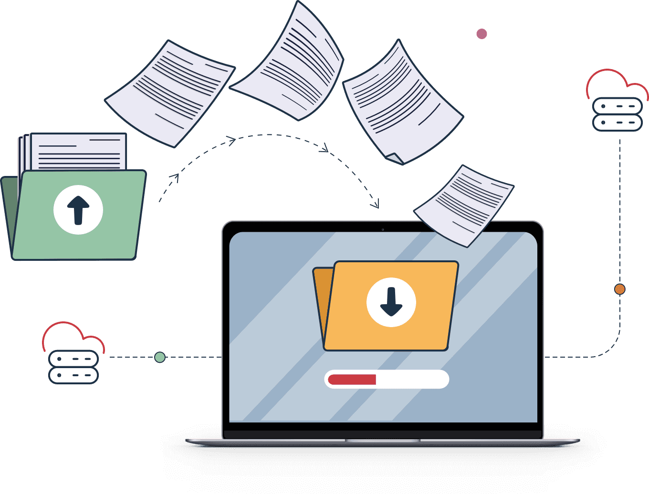
In this project, I describe how to run a paperless library and keep track of books, users, and records.
EXISTING SYSTEM
Manually search each book in the location where it is kept.
Maintenance of ledger books for borrowing and returning the book.

Slide 14
PROPOSED SYSTEM
In this project, describe how to run a paperless library and keep track of books, users, and records.

Slide 15
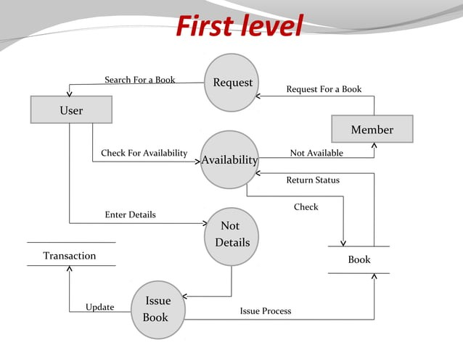
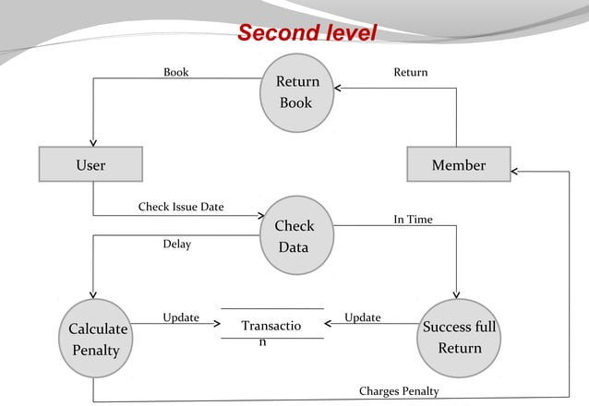
FLOW DIAGRAM
DATABASE DESIGN

Slide 16
FLOW DIAGRAM

Slide 17
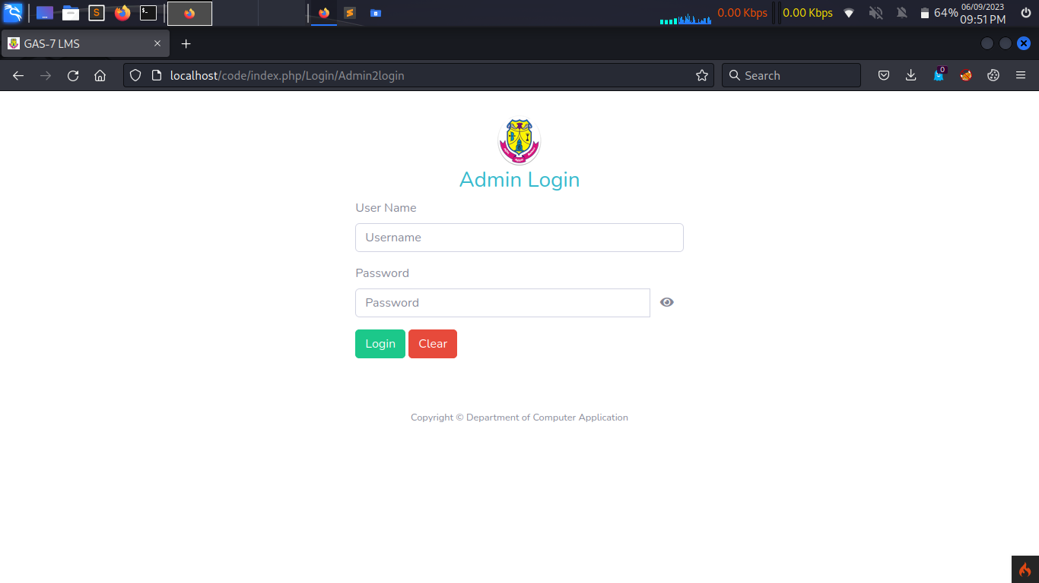
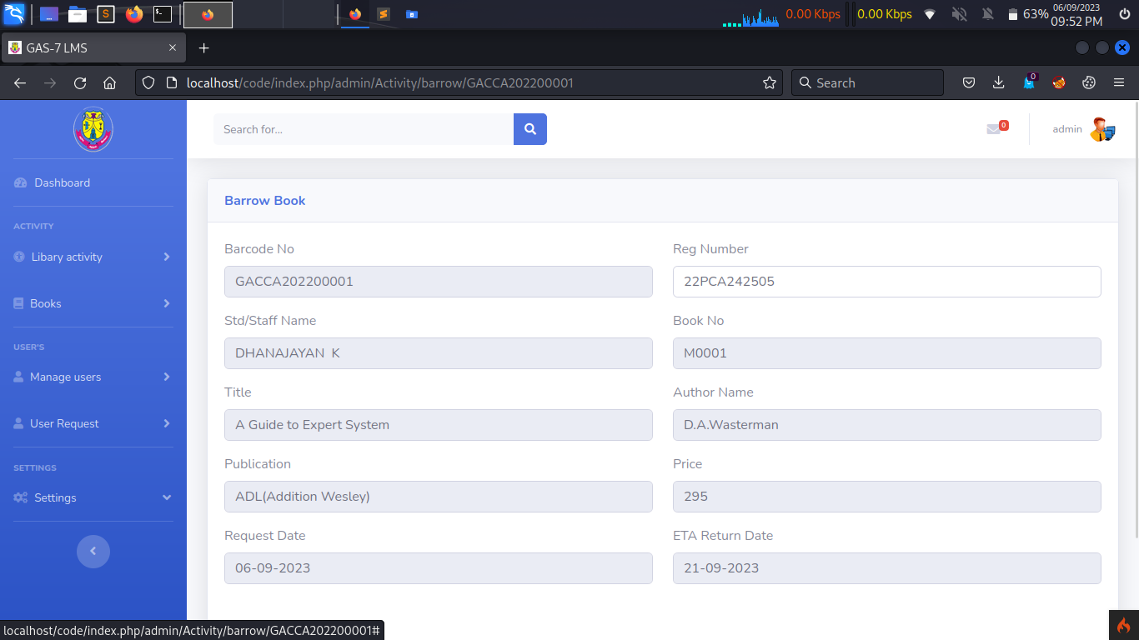
Input design

Slide 18
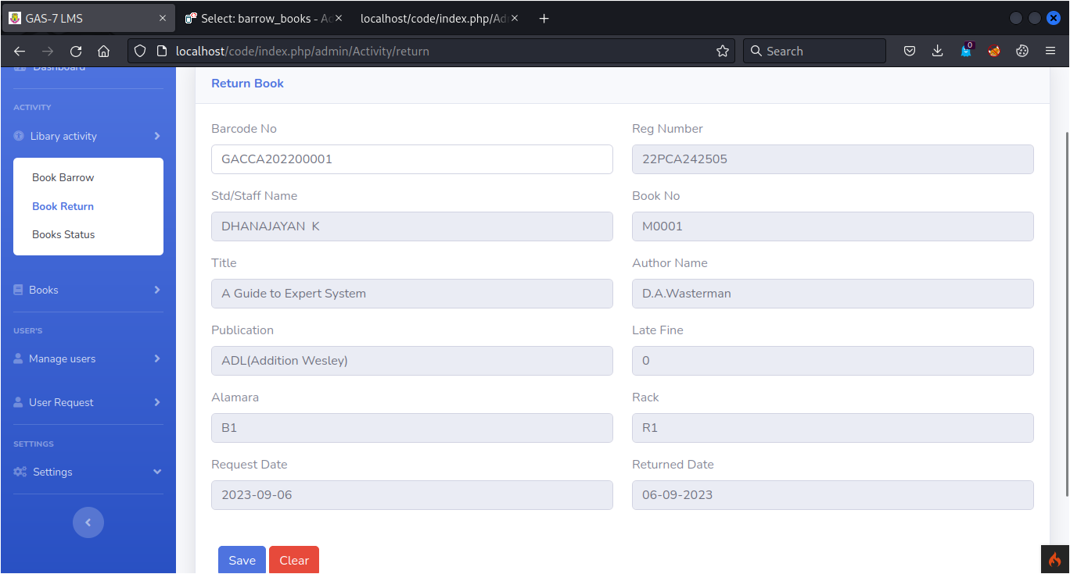
Input design

Slide 19
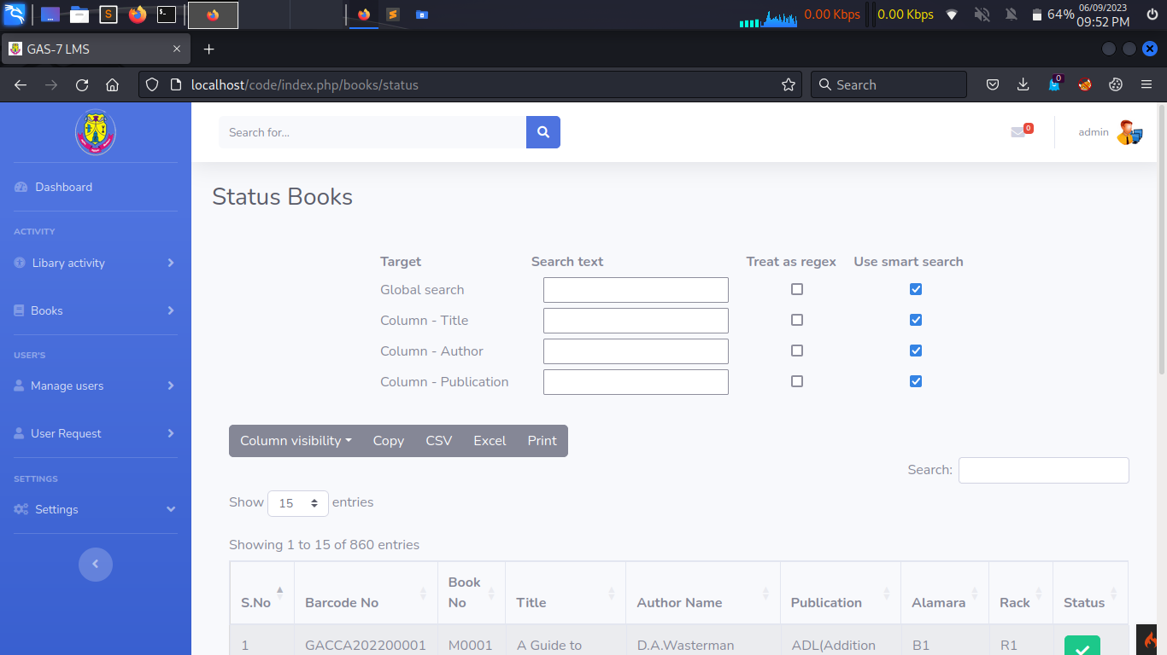
Input design

Slide 20
OUTPUT design
DB
FACULTY
STUDENTS
REQUEST LIST
BORROW BOOKS
MASTER BOOKS

Slide 21
DATABASE DESIGN
DB
FACULTY
STUDENTS
REQUEST LIST
BORROW BOOKS
MASTER BOOKS
ID(PRIMARY KEY)
BOOK No.
BAR CODE
AUTHER NAME
PUBLICATION
PRICE
RACK
STATUS

Slide 22
DATABASE DESIGN
DB
REQUEST LIST
FACULTY
STUDENTS
BORROW BOOKS
MASTER BOOKS
ID(PRIMARY KEY)
BOOK No.
TITLE
BAR CODE
AUTHOR NAME
PUBLICATION
PRICE
RACK
STATUS
ID (Primary Key):
Unique identifier for each book record.
BOOK No.:
A unique identifier for the book within the library.
TITLE:
The title of the book.
BAR CODE:
A unique identifier in barcode format for easy scanning.
AUTHOR NAME:
Name of the book's author.
PUBLICATION:
The publishing company or entity.
PRICE:
The cost of the book.
RACK:
The physical location of the book on library shelves.
STATUS:
Current status of the book (e.g., available, checked out).

Slide 23
DATABASE DESIGN
ID (Primary Key):
Unique identifier for each book record.
BOOK No.:
A unique identifier for the book within the library.
TITLE:
The title of the book.
BAR CODE:
A unique identifier in barcode format for easy scanning.
AUTHOR NAME:
Name of the book's author.
PUBLICATION:
The publishing company or entity.
PRICE:
The cost of the book.
RACK:
The physical location of the book on library shelves.
STATUS:
Current status of the book (e.g., available, checked out).
ID(PRIMARY KEY)
BOOK No.
TITLE
BAR CODE
AUTHOR NAME
PUBLICATION
PRICE
RACK
STATUS
DB
REQUEST LIST
FACULTY
STUDENTS
BORROW BOOKS
MASTER BOOKS
BID(PRIMARY KEY)
STUDENT/STAFF ID
BOOK ID
BARROW DATE
RETURN DATE
RETURNED DATE
IS RETURNED
STATUS

Slide 24
DATABASE DESIGN
TABLES
REQUEST LIST
FACULTY
STUDENTS
BORROW BOOKS
MASTER BOOKS
BID(PRIMARY KEY)
STUDENT/FACULTY ID
BOOK ID
BARROW DATE
RETURN DATE
RETURNED DATE
STATUS
BID (Primary Key):
Unique identifier for each transaction.
STUDENT/FACULTY ID:
Identifier for the student or faculty member involved in the transaction.
BOOK ID:
Identifier for the borrowed book.
BARROW DATE:
Date when the book was borrowed.
RETURN DATE:
Expected return date for the book.
RETURNED DATE:
Actual return date of the book.
STATUS:
Status of the transaction (e.g., pending, returned, overdue).
ID (Primary Key):
Unique identifier for each book record.
BOOK No.:
A unique identifier for the book within the library.
TITLE:
The title of the book.
BAR CODE:
A unique identifier in barcode format for easy scanning.
AUTHOR NAME:
Name of the book's author.
PUBLICATION:
The publishing company or entity.
PRICE:
The cost of the book.
RACK:
The physical location of the book on library shelves.
STATUS:
Current status of the book (e.g., available, checked out).

Slide 25
DATABASE DESIGN
SID(PRIMARY KEY)
REG. No
NAME
PASSWORD(ENCRYPTED)
GENDER
EMAIL
YEAR OF JOINING
SHIFT
BID(PRIMARY KEY)
STUDENT/STAFF ID
BOOK ID
BARROW DATE
RETURN DATE
RETURNED DATE
IS RETURNED
STATUS
BID (Primary Key):
Unique identifier for each transaction.
STUDENT/FACULTY ID:
Identifier for the student or faculty member involved in the transaction.
BOOK ID:
Identifier for the borrowed book.
BARROW DATE:
Date when the book was borrowed.
RETURN DATE:
Expected return date for the book.
RETURNED DATE:
Actual return date of the book.
STATUS:
Status of the transaction (e.g., pending, returned, overdue).
DB
REQUEST LIST
FACULTY
STUDENTS
BORROW BOOKS
MASTER BOOKS

Slide 26
DATABASE DESIGN
DB
REQUEST LIST
FACULTY
STUDENTS
MASTER BOOKS
BORROW BOOKS
SID(PRIMARY KEY)
REG. No.
NAME
PASSWORD(ENCRYPTED)
GENDER
EMAIL
YEAR OF JOINING
SHIFT
BID (Primary Key):
Unique identifier for each transaction.
STUDENT/FACULTY ID:
Identifier for the student or faculty member involved in the transaction.
BOOK ID:
Identifier for the borrowed book.
BARROW DATE:
Date when the book was borrowed.
RETURN DATE:
Expected return date for the book.
RETURNED DATE:
Actual return date of the book.
STATUS:
Status of the transaction (e.g., pending, returned, overdue).
SID (Primary Key):
Unique identifier for each student.
REG. No.:
Registration number or unique identifier for the student.
NAME:
Full name of the student.
PASSWORD (ENCRYPTED):
Encrypted password for secure authentication.
GENDER:
Gender of the student.
EMAIL:
Email address of the student.
YEAR OF JOINING:
Year when the student joined the institution.
SHIFT:
Shift in which the student is enrolled (e.g., morning, evening).

Slide 27
DATABASE DESIGN
CAFID(PRIMARY KEY)
REG. No
NAME
PASSWORD(ENCRYPTED)
GENDER
EMAIL
DESOGNATIONC
SID (Primary Key):
Unique identifier for each student.
REG. No.:
Registration number or unique identifier for the student.
NAME:
Full name of the student.
PASSWORD (ENCRYPTED):
Encrypted password for secure authentication.
GENDER:
Gender of the student.
EMAIL:
Email address of the student.
YEAR OF JOINING:
Year when the student joined the institution.
SHIFT:
Shift in which the student is enrolled (e.g., morning, evening).
SID(PRIMARY KEY)
REG. No
NAME
PASSWORD(ENCRYPTED)
GENDER
EMAIL
YEAR OF JOINING
SHIFT
DB
REQUEST LIST
FACULTY
STUDENTS
MASTER BOOKS
BORROW BOOKS

Slide 28
DATABASE DESIGN
DB
REQUEST LISTS
FACULTY
MASTER BOOKS
BORROW BOOKS
STUDENTS
CAFID(PRIMARY KEY)
REG. No.
NAME
PASSWORD(ENCRYPTED)
GENDER
EMAIL
DESOGNATIONC
FACULTYID (Primary Key):
Unique identifier for each faculty member.
REG. No.:
Registration number or unique identifier for the faculty.
NAME:
Full name of the faculty member.
PASSWORD (ENCRYPTED):
Encrypted password for secure authentication.
GENDER:
Gender of the faculty member.
EMAIL:
Email address of the faculty member.
DESIGNATION:
Designation or position of the faculty member (e.g., Professor, Guest Lecturer).
SID (Primary Key):
Unique identifier for each student.
REG. No.:
Registration number or unique identifier for the student.
NAME:
Full name of the student.
PASSWORD (ENCRYPTED):
Encrypted password for secure authentication.
GENDER:
Gender of the student.
EMAIL:
Email address of the student.
YEAR OF JOINING:
Year when the student joined the institution.
SHIFT:
Shift in which the student is enrolled (e.g., morning, evening).

Slide 29
DATABASE DESIGN
FACULTYID (Primary Key):
Unique identifier for each faculty member.
REG. No.:
Registration number or unique identifier for the faculty.
NAME:
Full name of the faculty member.
PASSWORD (ENCRYPTED):
Encrypted password for secure authentication.
GENDER:
Gender of the faculty member.
EMAIL:
Email address of the faculty member.
DESIGNATION:
Designation or position of the faculty member (e.g., Professor, Guest Lecturer).
RID(PRIMARY KEY)
REQUESTER ID
RECEVIER ID
MESSGAGE
REQUESTER ROLE
RECEVIER ROLE
STATUS
CAFID(PRIMARY KEY)
REG. No
NAME
PASSWORD(ENCRYPTED)
GENDER
EMAIL
DESOGNATIONC
DB
MASTER BOOKS
REQUEST LIST
BORROW BOOKS
STUDENTS
FACULTY

Slide 30
DATABASE DESIGN
DB
FACULTY
REQUEST LIST
MASTER BOOKS
BORROW BOOKS
STUDENTS
RID(PRIMARY KEY)
REQUESTER ID
RECEVIER ID
MESSGAGE
REQUESTER ROLE
RECEVIER ROLE
FACULTYID (Primary Key):
Unique identifier for each faculty member.
REG. No.:
Registration number or unique identifier for the faculty.
NAME:
Full name of the faculty member.
PASSWORD (ENCRYPTED):
Encrypted password for secure authentication.
GENDER:
Gender of the faculty member.
EMAIL:
Email address of the faculty member.
DESIGNATION:
Designation or position of the faculty member (e.g., Professor, Guest Lecturer).
RID (Primary Key):
Unique identifier for each request/notification.
REQUESTER ID:
Identifier for the user making the request/notification.
RECEIVER ID:
Identifier for the user receiving the request/notification (e.g., borrower or admin).
MESSAGE:
The content of the request or notification message.
REQUESTER ROLE:
Role of the requester (student or faculty or admin).
RECEIVER ROLE:
Role of the receiver (borrower, admin).

Slide 31
DATABASE DESIGN
RID (Primary Key):
Unique identifier for each request/notification.
REQUESTER ID:
Identifier for the user making the request/notification.
RECEIVER ID:
Identifier for the user receiving the request/notification (e.g., borrower and admin).
MESSAGE:
The content of the request or notification message.
REQUESTER ROLE:
Role of the requester (student or faculty or admin).
RECEIVER ROLE:
Role of the receiver (borrower, admin).
RID(PRIMARY KEY)
REQUESTER ID
RECEVIER ID
MESSGAGE
REQUESTER ROLE
RECEVIER ROLE
DB
MASTER BOOKS
BORROW BOOKS
FACULTY
STUDENTS
REQUEST LIST

Slide 32
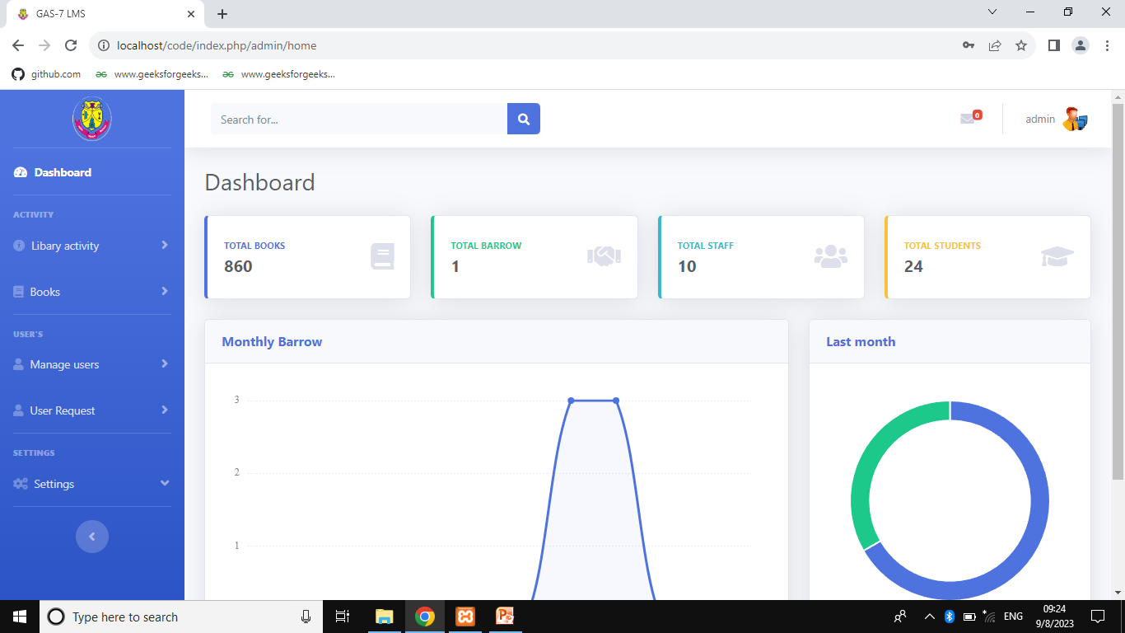
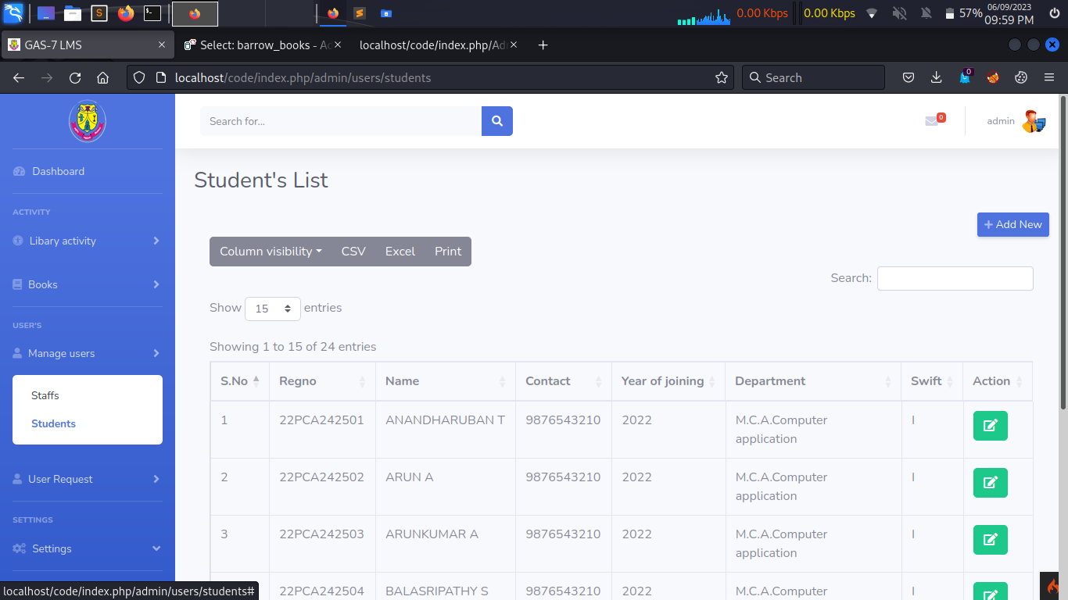
OUTPUT design
DB
MASTER BOOKS
BORROW BOOKS
FACULTY
STUDENTS
REQUEST LIST

Slide 33
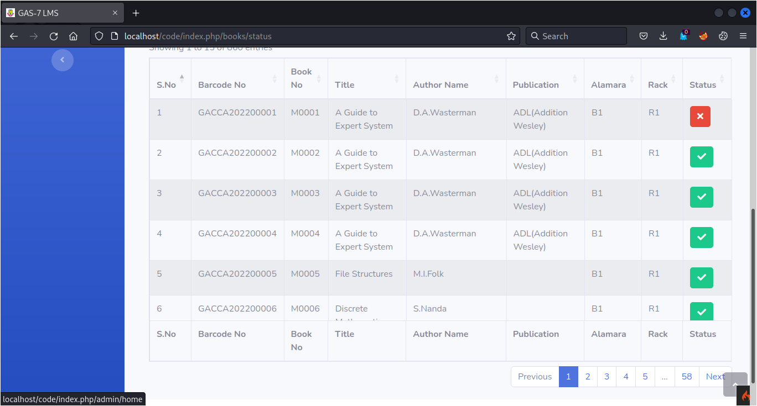
OUTPUT design

Slide 34

OUTPUT design

Slide 35

Any questions ?

Slide 36
Any questions ?

